Slide 1
Industrial Relations
Decent Workplace, International Labor Organisation, Industrial Relations, The Objectives of Industrial Relations, Approaches of Industrial Relations Systems, The Actors in Industrial Relations, Indian Context, Industrial Relations and Human Resource Management.

Slide 2
Decent Work
As per ILO Decent work sums up the aspirations of people in their working lives. It involves :
1.Opportunities for work that is productive and delivers a fair income.
2. Security in the workplace and social protection for all.
3.Better prospects for personal development and social integration.
4.Freedom for people to express their concerns, organize and participate in the decisions that affect their lives.
5.Equality of opportunity and treatment for all women and men.

Slide 3
The International Labour Organization (ILO)
The International Labour Organization (ILO) is devoted to promoting social justice and internationally recognized human and labour rights, pursuing its founding mission that social justice is essential to universal and lasting peace.
The only tripartite U.N. agency, since 1919 the ILO brings together governments, employers and workers of 187 Member States, to set labour standards, develop policies and devise programmes promoting decent work for all women and men.

Slide 4
ILO : Objectives
The ILO is a meeting point for governments, workers and employers of ILO’s member States to set labour standards, improve upon policies and create programs that promote decent work for people. The four strategic objectives at the heart of the Decent Work agenda are:
To develop and effectuate standards, fundamental principles, and fundamental rights at work.
To ensure that men and women have equal access to decent work while enhancing opportunities for the same.
To magnify the coverage and effectiveness of social protection for everyone.
To strengthen Tripartism and social dialogue.

Slide 5
MEANING
It is in the interest of everyone to create and maintain good relations between Employees and Employees.
According to Dale Yoder, “ IR refers to the relationship between management and employees or among employees and their organization that arise out of employment”.
Actors/Parties to Industrial Relations :
Employers and their Organization.
Employees and their Organization.
Trade Union.
Government (to protect the interest of both parties).

Slide 6
Objectives of IR :
To safeguard the interest of labour as well as management.
To raise productivity to the higher level.
To ensure industrial peace by eliminating the industrial disputes.
To establish and maintain the industrial democracy by WPM.
To reduce the labour turnover and absenteeism by providing Job Satisfaction.
To eliminate the Strikes, Lockouts, Gheraos etc by ensuring reasonable Wages and Fringe benefits.
To encourage and develop the Trade Union .
To ensure a healthy and balanced social life.

Slide 7
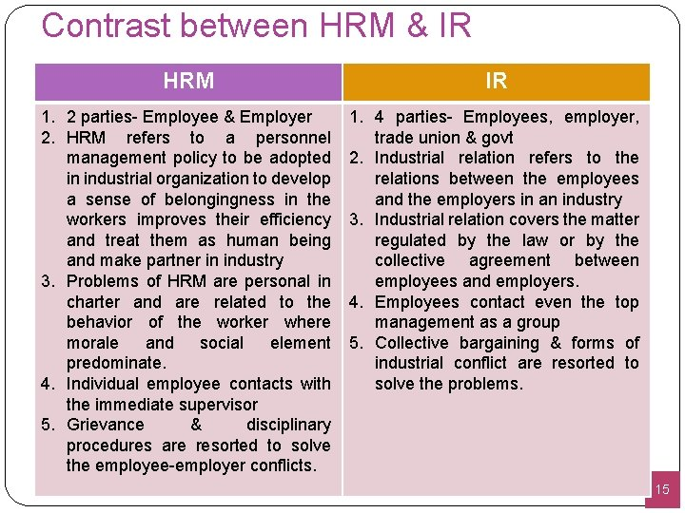
HRM And Industrial Relations

Slide 8
Approaches to Industrial Relations
The four popular approaches to industrial relations are :
1. The Unitary Approach.
2. Pluralistic Approach.
Marxist/ Radical Approach.
System Approach.

Slide 9
1. The Unitary Approach
Unitary Perspective of Industrial Relations views the industrial organization as an entity unified by one aim, and that is success. In unitarism, the organization is perceived as an integrated and harmonious system, viewed as one happy family.
As per this approach, Management reserve the right to manage and take decisions. And it is considered as legitimate, rational and accepted. And opposition to decision is considered as irrational.

Slide 10
2. Pluralistic Approach
This approach perceives organization as a coalition of competing interest between management and different groups, trade unions as legitimate representative of employee's interests and stability in Industrial Relation as the product of concessions and compromises between management and workers.
This approach believes that trade unions are legitimate representatives of employee interest and management authority is nor automatically accepted.

Slide 11
3. Marxist/ Radical Approach
Marxist approach is based on the proposition that the economic activities of production, manufacturing, and distribution are majorly governed by the objective of profit.
It also regard that conflict between employers and employees as inevitable.
This approach is based on the class conflict between have and have nots, controlled and controller, exploiter and exploited.

Slide 12
4. System Approach
As for this , individuals are part of an ongoing but independent social system. The behaviour, actions and role of the individuals are shaped by the cultures of the society.
As per this, IR system defines, at any one time in its development is regarded as comprised of certain actors, certain contexts and an ideology that finds the IR system together, and a body of rules created to govern the as actors at the workplace and the work community.

